Slide 1
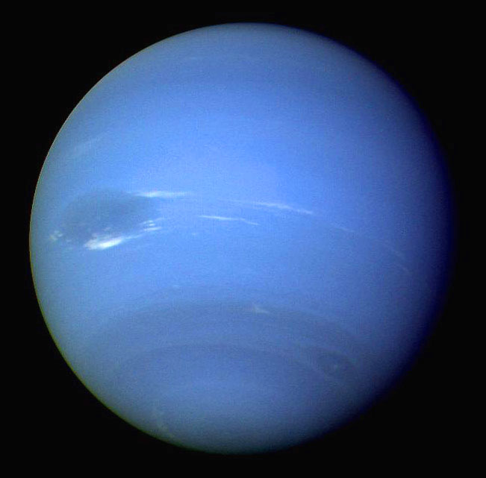
Neptune

Slide 2

Neptune was the first planet discovered with math…not with the naked eye or a telescope.
In 1821, French astronomer, Alexis Bouvard was studying Uranus and discovered that it was straying slightly from where they thought it should be.

Slide 3
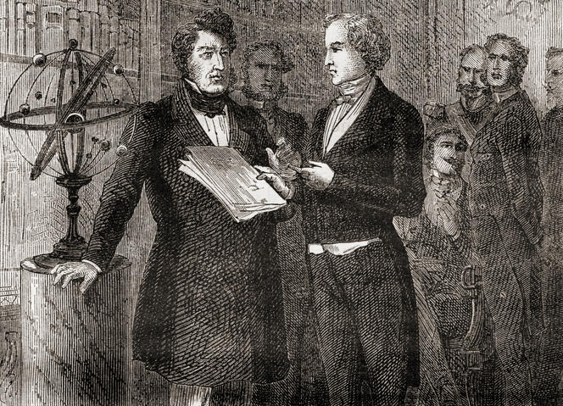
In the 1840s, England’s John Couch Adams & France’s Urbain Le Verrier worked out the math and began hunting for a new planet. On Sept. 23, 1846 Johann Galle from Germany found the planet where Adams & Le Verrier said it would be.

Slide 4
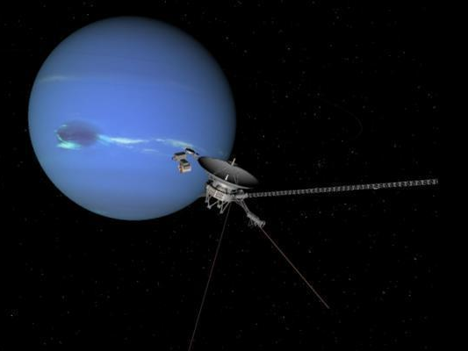
Voyager 2 passed by Neptune in 1989 & sent back images, 20 watts at a time.
This was the only time we’ve explored Neptune.
Traveling at light speed, the messages took over 4 hours to reach Earth.

Slide 5
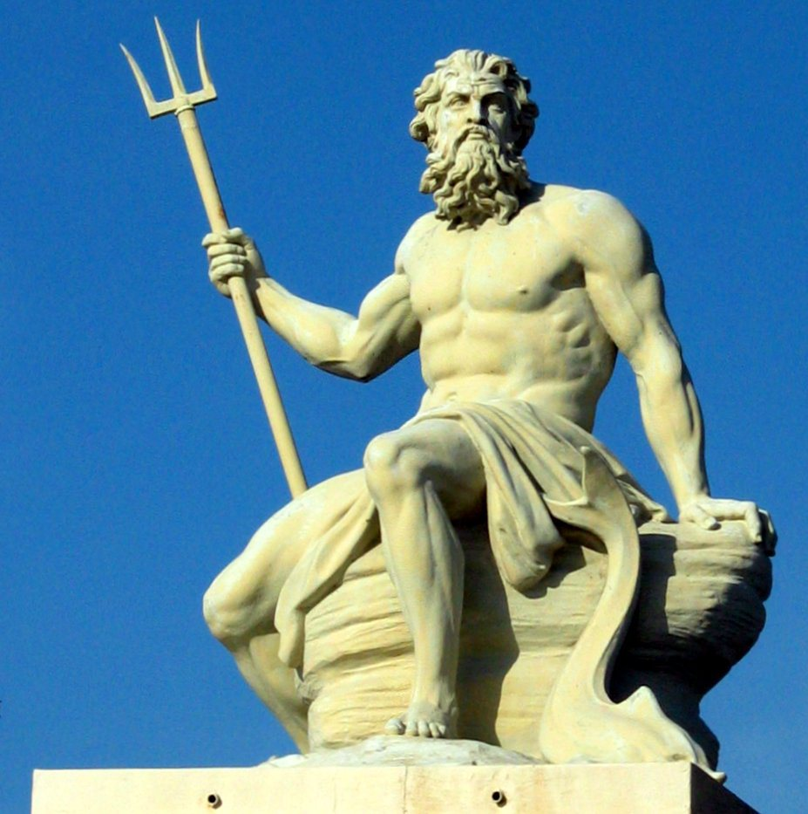
Neptune is named after the Roman god of the sea.
In Greek, his name is Poseidon.

Slide 6
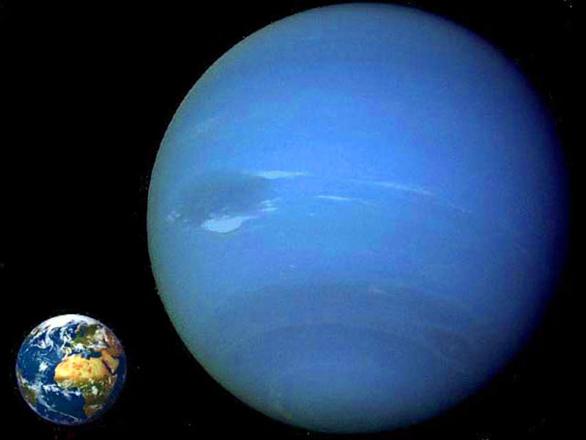
Neptune:
About 30,000 miles in diameter,
4x larger than Earth
Mass is 17x Earth
The 4th largest planet
Furthest planet from the Sun

Slide 7
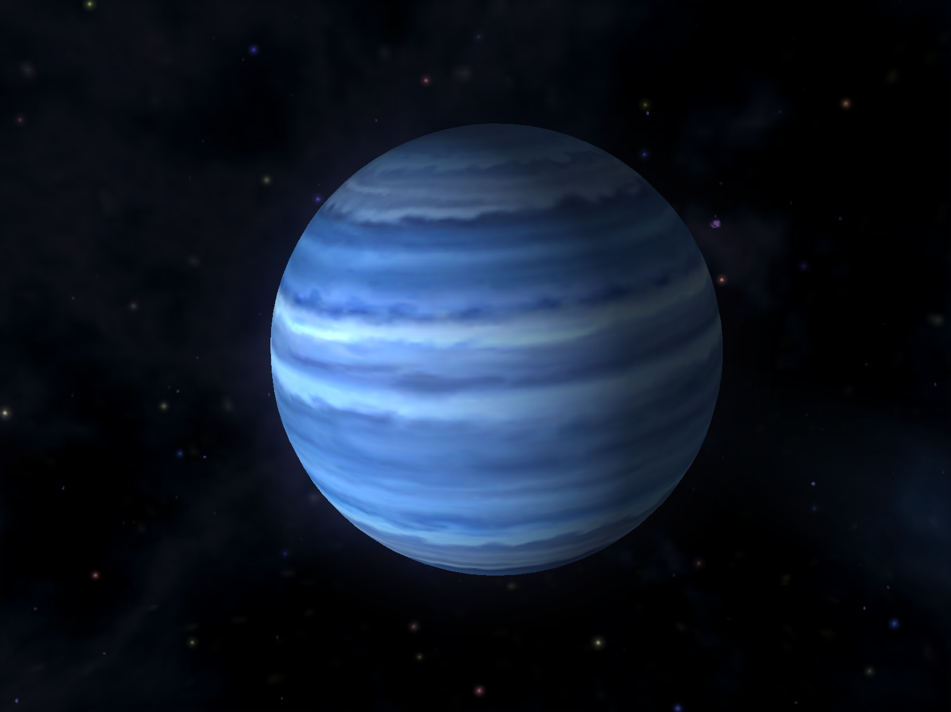
Neptune:
165 year orbit
2.8 billion miles from the Sun (Earth is 93 million miles from Sun)
Sun shines 900x brighter on Earth than Neptune

Slide 8
Neptune:
1 day averages 16 hours
  At equator, each rotation takes 18 hours.
  At poles, each rotation takes 12 hours.
Fastest winds in the solar system, consistently reaching 1,300 mph

Slide 9
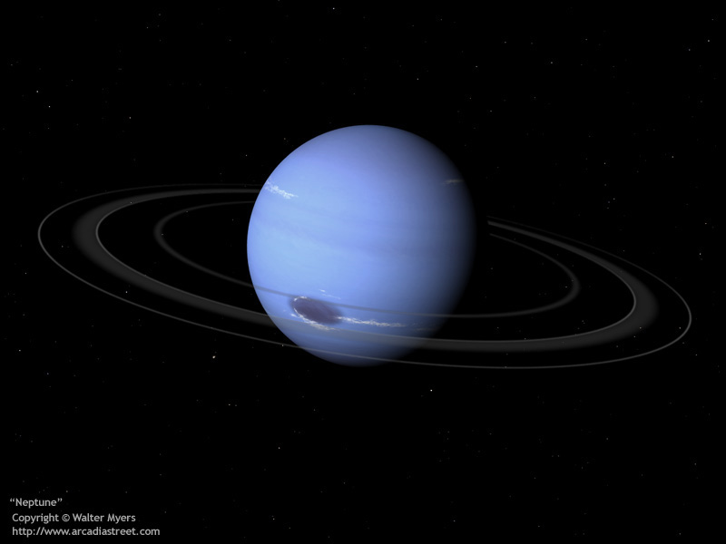
Neptune:
14 moons
5 thin rings
Axis is tilted 28⁰ (Earth is tilted at 23⁰) so it has subtle seasons…each lasting more than 41 years.

Slide 10
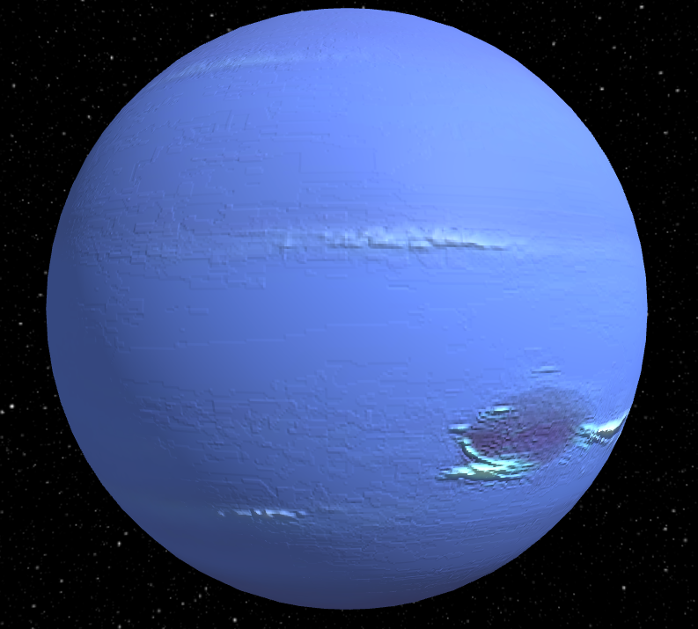
Neptune:
Atmosphere:
  80% hydrogen
  19% helium
  1% methane &
  other trace chemicals
Looks azure blue because of the methane.
Cloud top temperature: -360⁰ F
Internal temperature: 9,200⁰ F

Slide 11
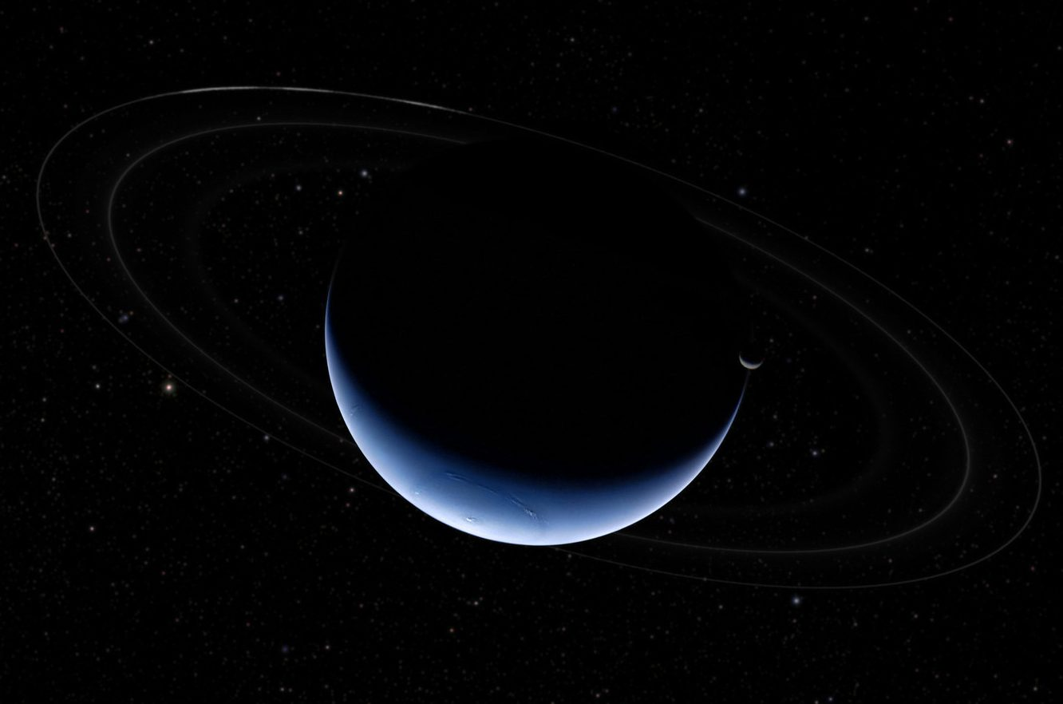
Rings of Neptune:
First spotted in 1968
Reddish in color, made mostly of dust-sized particles
5 rings called (from innermost to outermost): Galle, Le Verrier, Lassell, Arago & Adams
Ring width ranges from 60 miles to 3000 miles.
The Adams ring has very faint areas and 5 brighter arcs that are incredibly consistent.

Slide 12
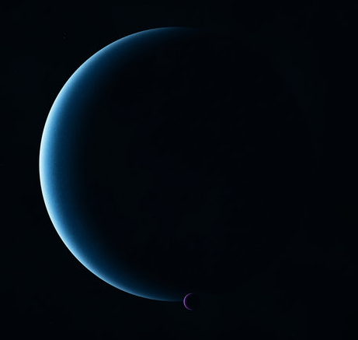
Moons of Neptune:
14 moons
12 are pretty small, less than 100 miles in diameter
Triton is the big one

Slide 13
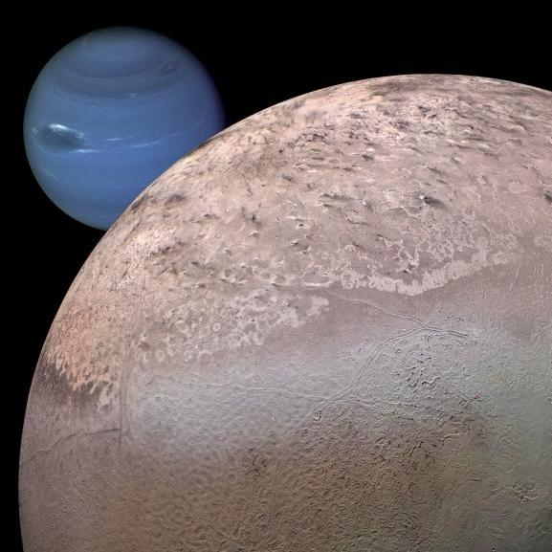
Triton
Discovered in 1846, just after Neptune itself
1674 miles in diameter
(3/4 size of our Moon)
Temperature
averages -390⁰,
the coldest place
in our solar system

Slide 14
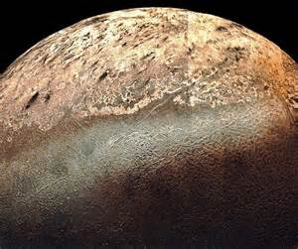
Triton
Covered in ice & would be 6x brighter than our Moon if it orbited Earth
White face has dark streaks…maybe geysers or volcanoes

Slide 15
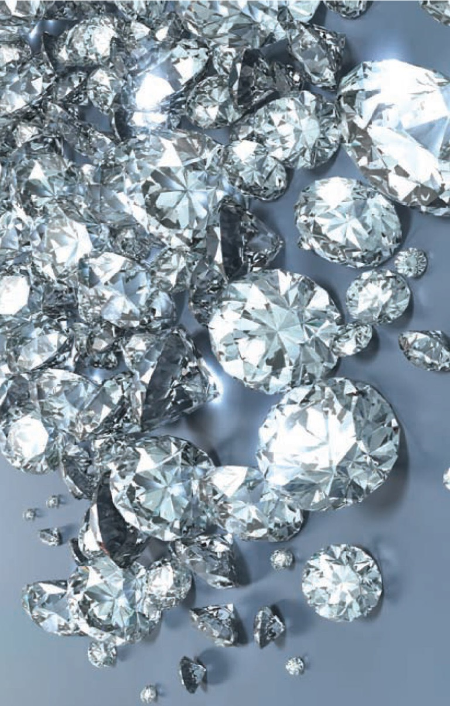
Neptune Diamonds???:
              Internal pressure is 100,000 times sea-level Earth pressure
              Internal temperature is about
9200⁰ F
              Pressure & temperature can cause methane to break apart into hydrogen & carbon.
              Carbon at high pressure becomes diamonds and at higher pressure becomes liquefied.
Neptune (and Uranus) might have oceans of liquefied diamonds with diamond icebergs & diamond hailstones falling from the sky.

